Slide 1
Digital 3.0 Overview
May 2022

Slide 2
Agenda
The Digital 3.0 Journey
Digital 3.0 Operating Model & Principles
Client Priorities Overview & Our Approach

Slide 3
CDTS is on the Digital 3.0 Journey to enable business value interactions with clients.
1.0
2.0
3.0
FY19/20: Chief Digital Office Established. Consulting Organization Established
FY21: Consulting and Digital Transformation Services Established
FY22: Begin Our Digital 3.0 Strategic Journey
Digital 3.0 is a 3-year strategy to rapidly scale CDTS and expand career opportunities for the team. A key objective is bringing our clients and our people together to create mutual value. The Digital 3.0 program aligns to the broader organizational goal of developing a consulting led organization. Success for Digital 3.0 will be measured across three primary metrics: $1.5B in 3 years, 30%+ YoY growth and 30% + GM. In order to achieve those metrics, CDTS must evolve its operating model and redefine ways of working.

Slide 4


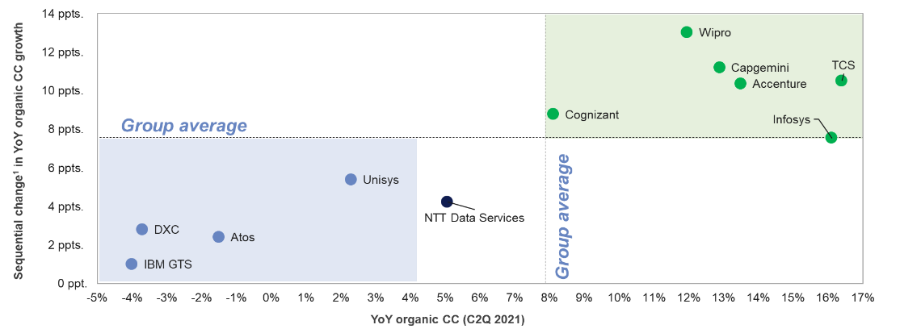
The Competition Has Changed
Our Heritage
Our Future
Infrastructure Companies
Digital and Application Companies
¹ Change of YoY organic cc growth in June ’21 over March ’21 quarter
Source: Everest Group (2021) & company reports
Notes:
Eric

Slide 5
Digital 3.0 Overview – The Strategy
Digital 3.0 is how NTT DATA is transforming itself to better transform our clients.
Who leads it?
What we GTM with?
Who we sell it to?
What can we deliver?
How we deliver it?
Industry challenges
Digital offerings and capabilities
Organization
Sales & Client Management Inbound/Outbound
Solutioning
CDTS + Hybrid
Cross industry solutions
Cross industry conversations
Vertical industry solutions
OCM to enable the strategy adoption and success
NTT DATA offerings and solutions
Differentiate ourselves in the market by taking a business problem, client centric and conversation led approach instead of capability/offering led discussions
We reorganized and restructured ourselves
Enable our sales and client community to become trusted advisors and increase our pipeline
Creating a need for additional larger hybrid solutions and deal structuring
One NTT
Notes:
Organization
How we are changing the organization to enable the strategy
Enabling our sales & client management with these client priorities
Inbound motions don’t change
The idea is that if we do have the inbound requests, how to we elevate these conversations
Outbound – enabling the sales community to do both top down and bottom up approaches with the client
Top-down and Bottom-up is how we introduce the client priorities
Either starts with business resilience and goes more indepth or the other way around
Solution
-

Slide 6



NTT DATA Portfolio in Action, Anchored in Business-Focused Solutions
Operating Model
Digital Experiences
Workforce Transformation
Business Resilience
Data-Driven Enterprise
Client Priorities
Industry, Technology & Business Consulting
Financial Services
Insurance
Manufacturing & Automotive
Health Plan
Health Provider
Life Sciences
Commercial
Public Sector
Digital Transformation
Digital Operations
Enterprise Applications
Application Development & Modernization
Application Management
Digital Workplace Services
Data & Intelligence
Cloud Transformation
Hybrid Infrastructure Managed Services
BPO & BPaaS
Network & Cybersecurity
Nucleus Intelligent Enterprise Platform
Notes:
IT Modernization
Campaigns
Acquired companies?

Slide 7






Our CDTS Operating Model Principles put driving client value at the core of everything we do.
Elevate the Conversation
Client-Facing Team Members
Client Transformation Engagements
Client Centric
Market Relevant Pricing & Engagement Models
Scaled Alliance Partnerships
Acquisition Success

Slide 8

It is imperative for business to accelerate their adoption to the digital strategy and operations to grow and stay competitive in the market. NTT DATA has identified four critical priorities to equip our clients with the resources and tools needed for continuous and sustained evolution in the ever-changing business world.
Business Resiliency
Data-Driven Enterprise
is an organization’s ability to unleash the power of data to drive actionable insights and empower rapid end-to-end process automation by applying analytics, AI and intelligent automation across the value chain
is an organization’s core capability to adapt, respond and recover from disruptions by transforming the existing business model while maintaining continuous business operations
Optimized Operations
Measured and Improved Experiences
Reduced Risk Exposure
Skills for the Future
Digital Channel Engagement
Digital First Mindset
Data Confidence
Data Excellence
Efficient remote collaboration
Optimized Actions
Workforce Transformation
Digital Experiences
Drive Change
Decreased Time To Market
elevates the human elements of your business to meet the demands of the future through modern talent strategies, new skills and capabilities, and innovative tools and technologies
Strengthened Business Resilience
drive digital engagement to expand access, improve satisfaction and maximize revenue by humanizing the digital experience at every touchpoint
Sustainable and Hybrid AI
Notes:
These 4 are meant to be used together -

Slide 9
Client Priorities – Overview
The goal of the client priorities packages is to point us to an Advisory-led or Advisory-aligned approach.
Client Priorities
Business Resiliency
Data-Driven Enterprise
Digital Experiences
Workforce Transformation
Simplify the Complex
Data Fluency & Confidence
Engaging our Customers on Digital Channels
Driving change and adoption
Conversation Topics
Reduce Risk Exposure
Integrated Data Fabric
Prioritize Deliver Digital Transformation Roadmap
Skills for the future
Autonomous Operations
Accessible Insights
Deliver Experience across all channels of engagement
Data driven talent strategies
Scale Innovation
Data Driven Culture
Manage digital portfolio to measure/ improve experiences
Attract and retain the right talent
Workforce Transformation
Human: Machine Optimization

Slide 10




Our Approach – Client Priorities
The first step is to begin to create standard, consistent language for Digital 3.0 that is used to inform communications and talking points for the program.
Fail
Learn
Improve
Fast
Client Priorities
30 days
Late 2021, four client priorities areas were identified as the main drivers for digital transformation cross industry
Develop packages
Develop Packages
Evaluate Client Priorities
Client Priority leads curated packages to articulate the value proposition of addressing business problems to enable the sales community
SFDC conversations and pipeline impact
Training and Knowledge Management
Enable Sales Community
Go to Market
Enable sales community
Use the packages to enable our sales and client community to become trusted advisors and increase our pipeline
60 days
30 days
Go To Market
Differentiate ourselves in the market by taking a business problem, client centric and conversation led
Enable continuous improvement

Slide 11
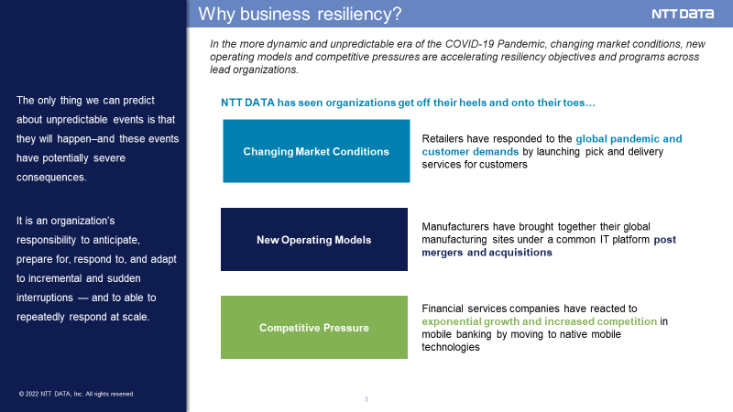
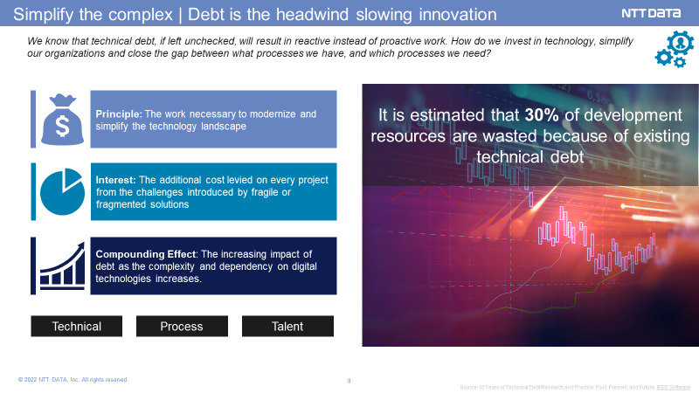
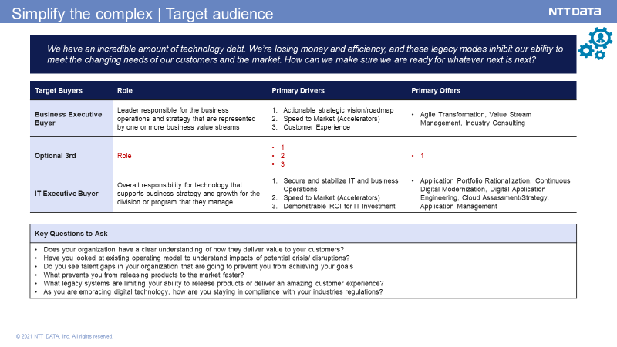
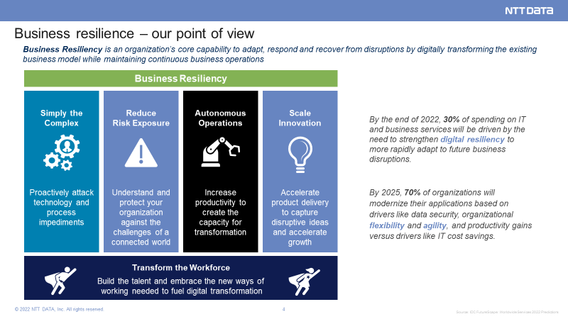
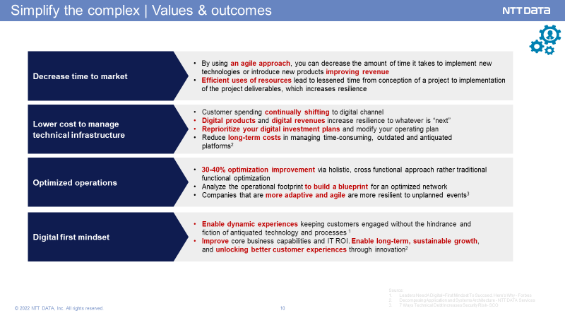
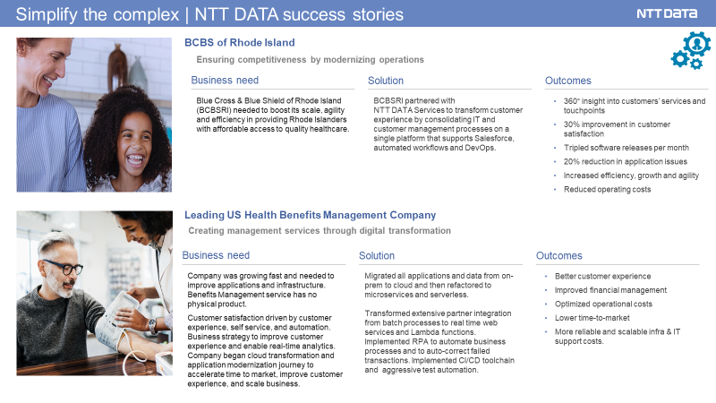
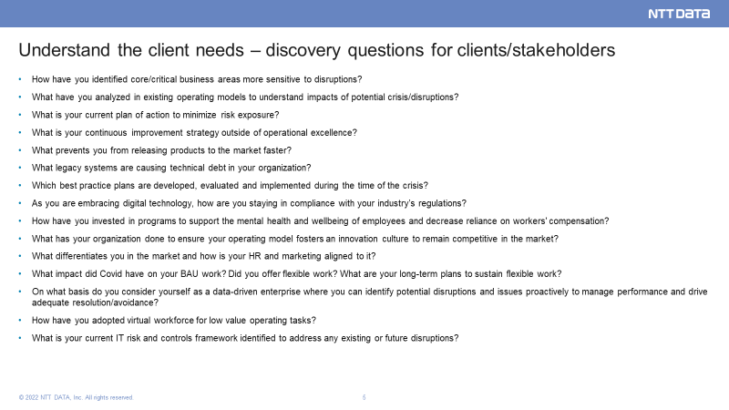
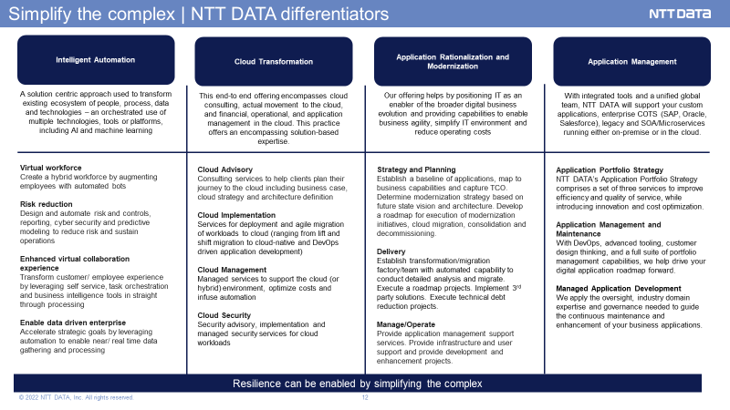
Aligning a Package to the Client Priorities: EXAMPLE
Why is this convo relevant?
Personas
Values & Outcomes
Use cases/ Success stories
Differentiators

